Slide 1
Algorithms and Data Structures
Lecture XV
Simonas Šaltenis
Nykredit Center for Database Research
Aalborg University
simas@cs.auc.dk

Slide 2
This Lecture
Tractable and intractable alg. Problems
  What is a ”reasonable” running time?
  NP problems, examples
  NP-complete problems and polynomial reducability
What have we learned?

Slide 3
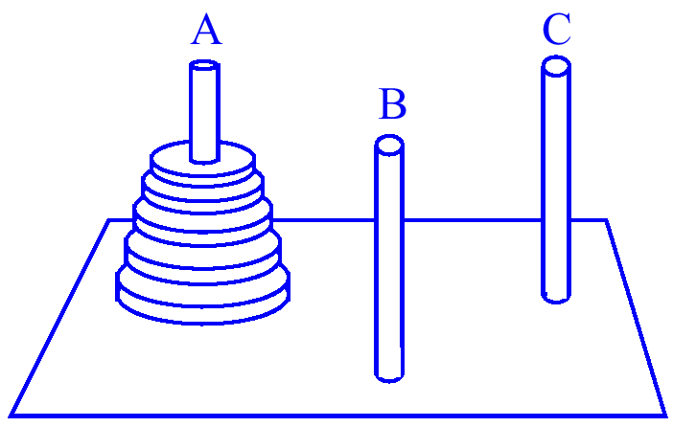
Towers of Hanoi
Goal: transfer all n disks from peg A to peg C
Rules:
  move one disk at a time
  never place larger disk above smaller one
Recursive solution:
  transfer n − 1 disks from A to B
  move largest disk from A to C
  transfer n − 1 disks from B to C
Total number of moves:
  T(n) = 2T(n − 1) + 1

Slide 4
Towers of Hanoi (2)
Recurrence relation:
  T(n) = 2 T(n − 1) + 1
  T(1) = 1
Solution by repeated substitution:
  T(n) = 2 (2 T(n - 2) + 1) + 1 =
  = 4 T(n - 2) + 2 + 1 =
  = 4 (2 T(n - 3) + 1) + 2 + 1 =
  = 8 T(n - 3) + 4 + 2 + 1 = ...
  = 2^{i} T(n - i) + 2^{i-1} +2^{i-2} +...+2¹ +2⁰
the expansion stops (n - i = 1) when i = n − 1
  T(n) = 2^{n – 1} + 2^{n – 2} + 2^{n – 3} + ... + 2¹ + 2⁰

Slide 5
Towers of Hanoi (3)
This is a geometric series, so that we have
  T(n) = 2^{n} − 1 = O(2^{n})
The running time of this algorithm is exponential (k^{n}) rather than polynomial (n^{k})
Good or bad news?
  the Induist priests were confronted with a tower problem of 64 rings...
  assuming one could move 1 million rings per second, it would take half a million years to complete the process...
  One move per second = 585 billion years!

Slide 6
Monkey Puzzle
Are such long running times linked to the size of the solution of an algorithm?
  No! To show that, we in the following consider only TRUE/FALSE or yes/no problems – decision problems
Nine square cards with imprinted “monkey halves”
The goal is to arrange the cards in 3x3 square with matching halves...

Slide 7
More Monkey...
Assumption: orientation is fixed
Does any MxM arrangement exist that fulfills the matching criterion?
Brute-force algorithm would take n! times to verify whether a solution exists
  assuming n = 25, it would take 490 billion years on a one-million-per- second arrangements computer to verify whether a solution exists

Slide 8
Monkey (3)
Improving the algorithm
  discarding partial arrangements
  etc.
A smart algorithm would still take a couple of thousand years in the worst case
Is there an easier way to find solutions? MAYBE! But nobody has found them, yet! (room for smart students...)

Slide 9
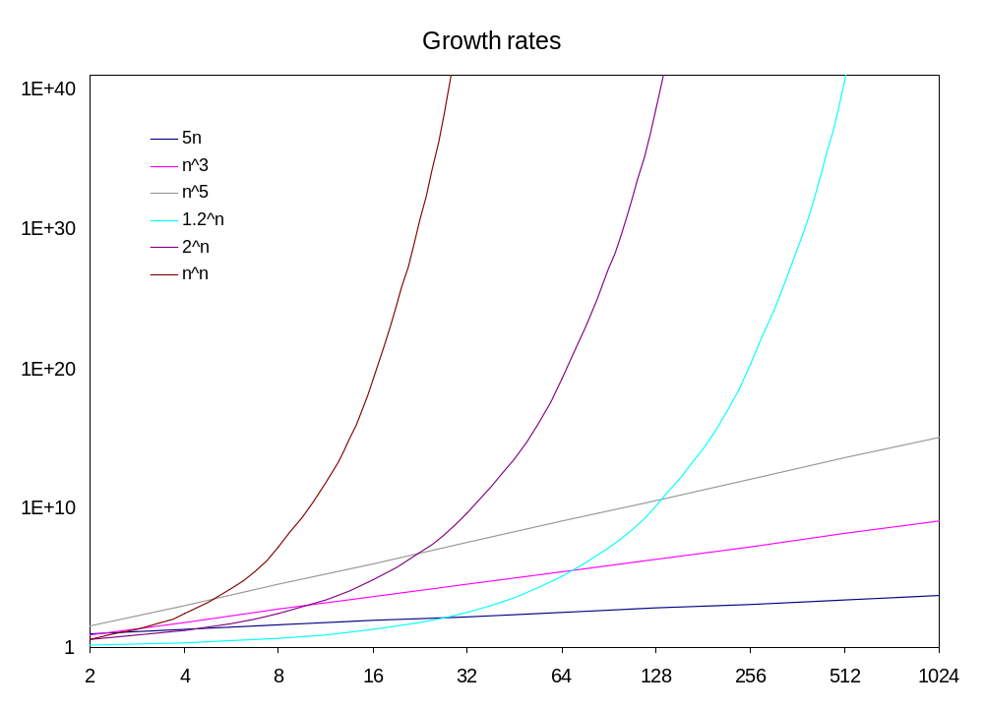
Reasonable vs. Unreasonable
Number of microseconds since “Big-Bang”

Slide 10
Reasonable vs. Unreasonable
function/ n | 10 | 20 | 50 | 100 | 300
n² | 1/10,000 second | 1/2,500 second | 1/400 second | 1/100 second | 9/100 second
n⁵ | 1/10 second | 3.2 seconds | 5.2 minutes | 2.8 hours | 28.1 days
2^{n} | 1/1000 second | 1 second | 35.7 years | 400 trillion centuries | a 75 digit-number of centuries
n^{n} | 2.8 hours | 3.3 trillion years | a 70 digit-number of centuries | a 185 digit-number of centuries | a 728 digit-number of centuries
Polynomial
Exponential

Slide 11
Reasonable vs. Unreasonable
”Good”, reasonable algorithms
  algorithms bound by a polynomial function n^{k}
  Tractable problems
”Bad”, unreasonable algorithms
  algorithms whose running time is above n^{k}
  Intractable problems
problems not admitting reasonable algorithms
intractable problems
tractable problems
problems admitting reasonable (polynomial-time) algorithms

Slide 12
So What!
Computers become faster every day
  insignificant (a constant) compared to exp. running time
Maybe the Monkey puzzle is just one specific problem, we could simply ignore
  the monkey puzzle falls into a category of problems called NPC (NP complete) problems (~1000 problems)
  all admit unreasonable solutions
  not known to admit reasonable ones…

Slide 13
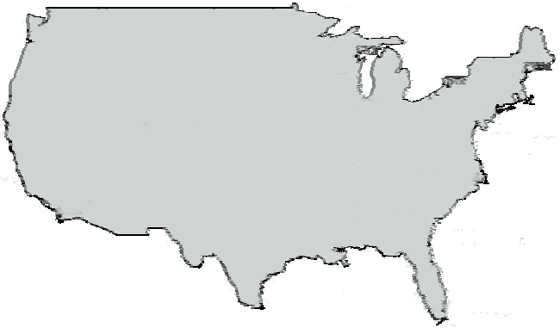
Traveling Salesman Problem
A traveling salesperson needs to visit n cities
Is there a route of at most d length? (decision problem)
  Optimization-version asks to find a shortest cycle visiting all vertices once in a weighted graph

Slide 14
TSP Algorithms
Naive solutions take n! time in worst-case, where n is the number of edges of the graph
No polynomial-time algorithms are known
  TSP is an NP-complete problem
Longest Path problem between A and B in a weighted grapah is also NP-complete
  Remember the running time for the shortest path problem

Slide 15
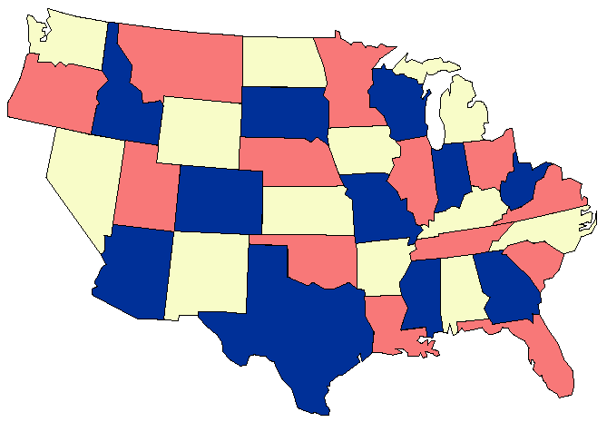
Coloring Problem (COLOR)
3-color
  given a planar map, can it be colored using 3 colors so that no adjacent regions have the same color
Find an error! =>

Slide 16
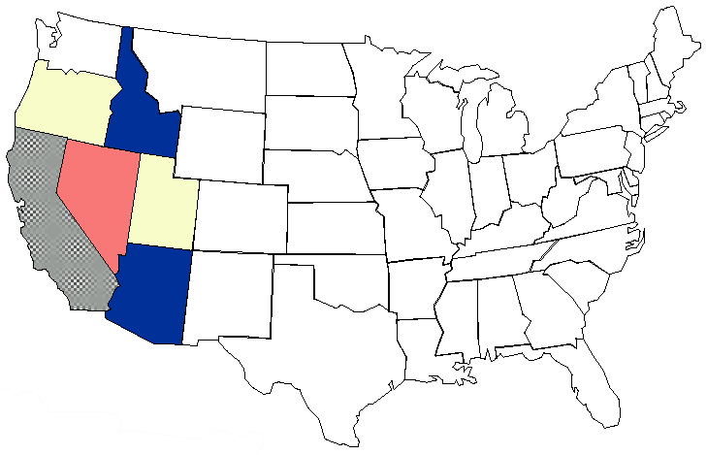
Coloring Problem (2)
NO instance
Impossible to 3-color Nevada and bordering states!

Slide 17
Coloring Problem (3)
Any map can be 4-colored
Maps that contain no points that are the junctions of an odd number of states can be 2-colored
No polynomial algorithms are known to determine whether a map can be 3-colored – it’s an NP-complete problem

Slide 18
Determining Truth (SAT)
Determine the truth or falsity of logical sentences in a simple logical formalism called propositional calculus
Using the logical connectives (&-and, ∨-or, ~-not,
→-implies) we compose expressions such as the following
  ~(E → F) & (F ∨ (D → ~E))
The algorithmic problem calls for determining the satisfiability of such sentences
  e.g., E = true, D and F = false

Slide 19
Determining Truth (SAT)
Exponential time algorithm on n = the number of distinct elementary assertions (O(2^{n}))
Best known solution, problem is in NP-complete class!

Slide 20
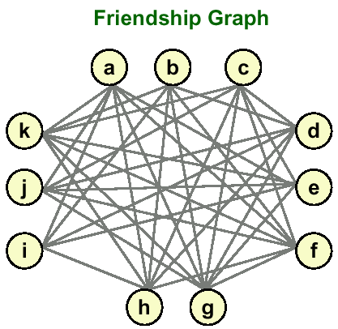
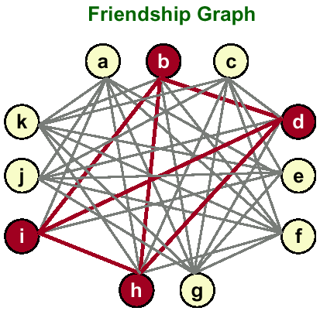
CLIQUE
Given n people and their pairwise relationships, is there a group of s people such that every pair in the group knows each other
  people: a, b, c, …, k
  friendships: (a,e), (a,f),…
  clique size: s = 4?
  YES, {b, d, i, h} is a
  certificate!

Slide 21
P
Definition of P:
  Set of all decision problems solvable in polynomial time on a deterministic Turing machine
Examples:
  SHORTEST PATH: Is the shortest path between u and v in a graph shorter than k?
  RELPRIME: Are the integers x and y relatively prime?
    YES: (x, y) = (34, 39).
  MEDIAN: Given integers x₁ , …, x_{n} , is the median value < M?
    YES: (M, x₁ , x₂ , x₃ , x₄ , x₅ ) = (17, 2, 5, 17, 22, 104)

Slide 22
P (2)
P is the set of all decision problems solvable in polynomial time on REAL computers.

Slide 23
Short Certificates
To find a solution for an NPC problem, we seem to be required to try out exponential amounts of partial solutions
Failing in extending a partial solution requires backtracking
However, once we found a solution, convincing someone of it is easy, if we keep a proof, i.e., a certificate
The problem is finding an answer (exponential), but not verifying a potential solution (polynomial)

Slide 24
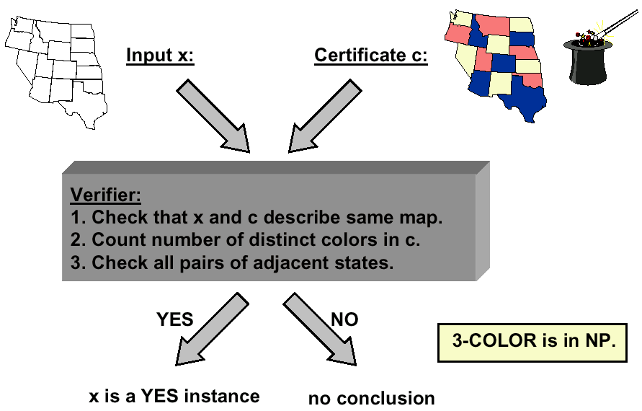
Short Certificates (2)

Slide 25
On Magic Coins and Oracles
Assume we use a magic coin in the backtracking algorithm
  whenever it is possible to extend a partial solutions in ”two” ways, we perform a coin toss (two monkey cards, next truth assignment, etc.)
  the outcome of this ”act” determines further actions – we use magical insight, supernatural powers!
Such algorithms are termed ”non-deterministic”
  they guess which option is better, rather than employing some deterministic procedure to go through the alternatives

Slide 26
NP
Definition of NP:
  Set of all decision problems solvable in polynomial time on a NONDETERMINISTIC Turing machine
  Definition important because it links many fundamental problems
Useful alternative definition
  Set of all decision problems with efficient verification algorithms
    efficient = polynomial number of steps on deterministic TM
  Verifier: algorithm for decision problem with extra input

Slide 27
NP (2)
NP = set of decision problems with efficient verification algorithms
Why doesn’t this imply that all problems in NP can be solved efficiently?
  BIG PROBLEM: need to know certificate ahead of time
    real computers can simulate by guessing all possible certificates and verifying
    naïve simulation takes exponential time
    unless you get "lucky"

Slide 28
NP-Completeness
Informal definition of NP-hard:
  A problem with the property that if it can be solved efficiently, then it can be used as a subroutine to solve any other problem in NP efficiently
NP-complete problems are NP problems that are NP-hard
  ”Hardest computational problems” in NP

Slide 29
NP-Completeness (2)
Each NPC problem’s faith is tightly coupled to all the others (complete set of problems)
Finding a polynomial time algorithm for one NPC problem would automatically yield a polynomial time algorithm for all NP problems
Proving that one NP-complete problem has an exponential lower bound woud automatically proove that all other NP-complete problems have exponential lower bounds

Slide 30
NP-Completeness (3)
How can we prove such a statement?
Polynomial time reduction!
  given two problems
  it is an algorithm running in polynomial time that reduces one problem to the other such that
    given input X to the first and asking for a yes/no answer
    we transform X into input Y to the second problem such that its answer matches the answer of the first problem

Slide 31
Reduction Example
Reduction is a general technique for showing that one problem is harder (easier) than another
  For problems A and B, we can often show: if A can be solved efficiently, then so can B
  In this case, we say B reduces to A (B is "easier" than A, or, B cannot be ”worse” than A)

Slide 32
Redcution Example (2)
SAT reduces to CLIQUE
  Given any input to SAT, we create a corresponding input to CLIQUE that will help us solve the original SAT problem
  Specifically, for a SAT formula with K clauses, we construct a CLIQUE input that has a clique of size K if and only if the original Boolean formula is satisfiable
  If we had an efficient algorithm for CLIQUE, we could apply our transformation, solve the associated CLIQUE problem, and obtain the yes/no answer for the original SAT problem

Slide 33
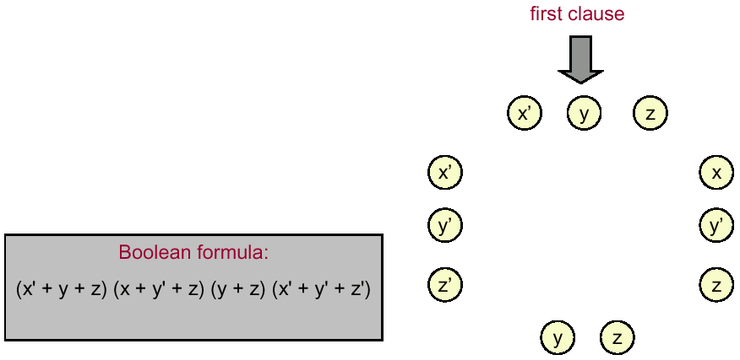
Reduction Example (3)
SAT reduces to CLIQUE
  Associate a person to each variable occurrence in each clause

Slide 34
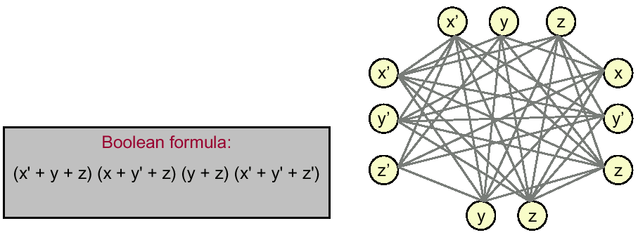
Reduction Example (4)
SAT reduces to CLIQUE
  Associate a person to each variable occurrence in each clause
  ”Two people” know each other except if:
    they come from the same clause
    they represent t and t’ for some variable t

Slide 35
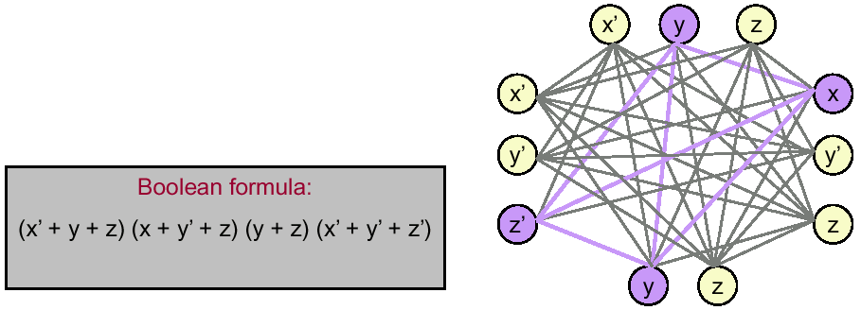
Reduction Example (5)
SAT reduces to CLIQUE
  Two people know each other except if:
    they come from the same clause
    they represent t and t’ for some variable t
  Clique of size 4 ⇒ satisfiable assignment
    set variable in clique to ”true”
    (x, y, z) = (true, true, false)

Slide 36
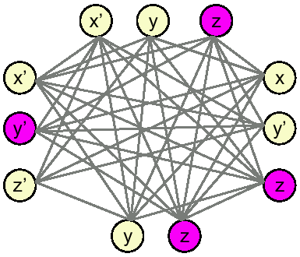
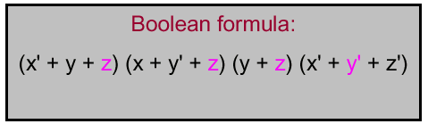
Reduction Example (6)
SAT reduces to CLIQUE
  Two people know each other except if:
    they come from the same clause
    they represent t and t’ for some variable t
  Clique of size 4 ⇒ satisfiable assignment
  Satisfiable assignment ⇒ clique of size 4
    (x, y, z) = (false, false, true)
    choose one true literal from
    each clause

Slide 37
CLIQUE is NP-complete
CLIQUE is NP-complete
  CLIQUE is in NP
  SAT is in NP-complete
  SAT reduces to CLIQUE
Hundreds of problems can be shown to be NP-complete that way…

Slide 38
The Start…
The World’s first NP-complete problem
SAT is NP-complete. (Cook-Levin, 1960’s)

Slide 39
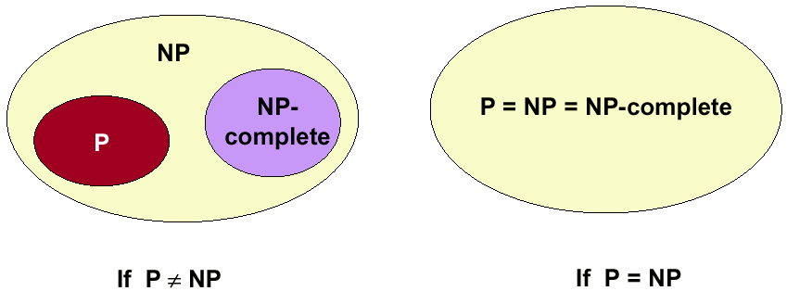
The Main Question
Does P = NP?
  Is the original DECISION problem as easy as VERIFICATION?
Most important open problem in theoretical computer science. Clay institute of mathematics offers one-million dolar prize!

Slide 40
The Main Question (2)
If P=NP, then:
  Efficient algorithms for 3- COLOR, TSP, and factoring.
  Cryptography is impossible on conventional machines
  Modern banking system will collapse
If no, then:
  Can’t hope to write efficient algorithm for TSP
    see NP- completeness
  But maybe efficient algorithm still exists for testing the primality of a number – i.e., there are some problems that are NP, but not NP-complete

Slide 41
The Main Question (3)
Probably no, since:
  Thousands of researchers have spent four decades in search of polynomial algorithms for many fundamental NP-complete problems without success
  Consensus opinion: P ≠ NP
But maybe yes, since:
  No success in proving P ≠ NP either

Slide 42
Dealing with NP-Completeness
Hope that a worst case doesn’t occur
  Complexity theory deals with worst case behavior. The instance(s) you want to solve may be "easy"
    TSP where all points are on a line or circle
    13,509 US city TSP problem solved (Cook et. al., 1998)
Change the problem
  Develop a heuristic, and hope it produces a good solution.
  Design an approximation algorithm: algorithm that is guaranteed to find a high- quality solution in polynomial time
    active area of research, but not always possible
Keep trying to prove P = NP.

Slide 43
The Big Picture
Summarizing: it is not known whether NP problems are tractable or intractable
But, there exist provably intractable problems
  Even worse – there exist problems with running times unimaginably worse than exponential!
More bad news: there are provably noncomputable (undecidable) problems
  There are no (and there will not ever be!!!) algorithms to solve these problems

Slide 44
The Course
Toolbox of algorithmic techniques
  Divide and Conquer (Merge sort, Quicksort, Binary search, Closest pair)
  Dynamic programming (Matrix chain multiplication, Longest Common Subsequence)
  Greedy algorithms (Prim’s, Kruskal’s, Dijkstra’s)
  Sweeping in computational geometry
Analysis of algorithms:
  Correctness of algorithm
  Asymptotic notations
  Recurrences

Slide 45
The Course (2)
Building algorithms - concept of ADT
Toolbox of data structures:
  Simple data structures (array, all sorts of linked lists, stacks, queues, trees, heaps)
  Dictionaries (fast data access)
    binary trees (unbalanced)
    red-black trees

Slide 46
The Course (3)
Toolbox of algorithms:
  Sorting
    insertion sort, selection sort
    merge sort
    quick sort
    heap sort (priority queues)
  Graphs
    memory representation
    graph traversal
      breadth-first search
      depth-first search (topological sort)
    minimum spanning trees (Prim, Kruskal)
    shortest path (Dijkstra, Bellman-Ford)

Slide 47
The Course (4)
Toolbox of algorithms:
  Computational Geometry
    sweep line
    line segment intersections
    closest pairs
Complexity classes
  what’s good and what’s not
  NP-completeness
  reducibility and examples

